Slide 1
Analysis and Data Mining of two large data sets using Various Visualization Techniques
Rohit Khadse(L20407353)
Saurabh Mahajan(L20398116)

Slide 2
Introduction to Data Sets
We used the following two data sets
OnCampusArrest
24 attributes and 11064 tuples
2. NonCampusArrest
24 attributes and 11064 tuples
The data set show the tabular data of arrests that took place across various colleges all over US.

Slide 3
Proposal
The aim of the project was analysing the 2 data sets and interpreting the areas where the arrest rate is high.
We applied various Visualization techniques as well as K-means Clustering to find different variations and results.
Softwares used: Rstudio, MYSQL Workbench

Slide 4
Tasks Performed
Pre-Processing
Visualization techniques
K-means Clustering

Slide 5
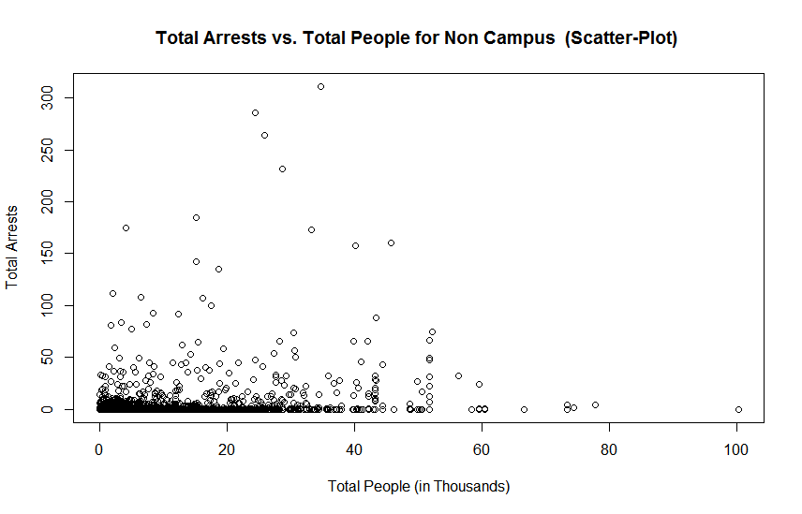
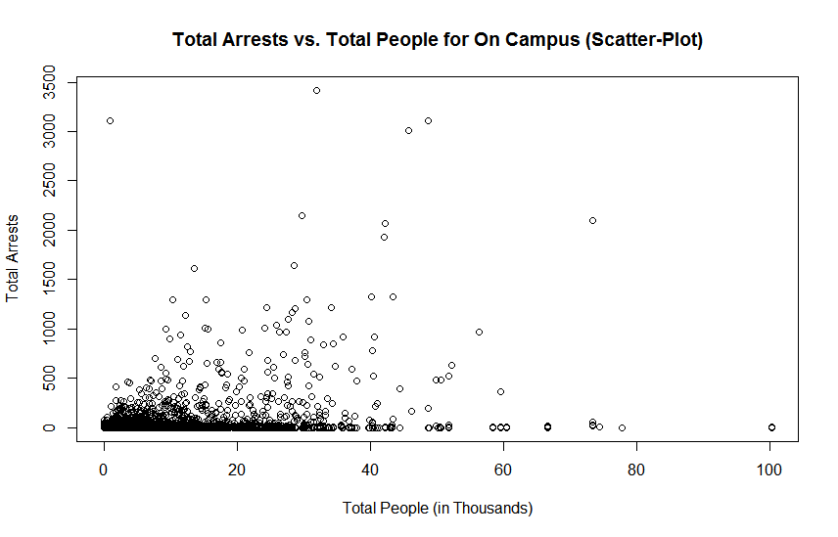
Output/Inferences
Scatter Plot

Slide 6
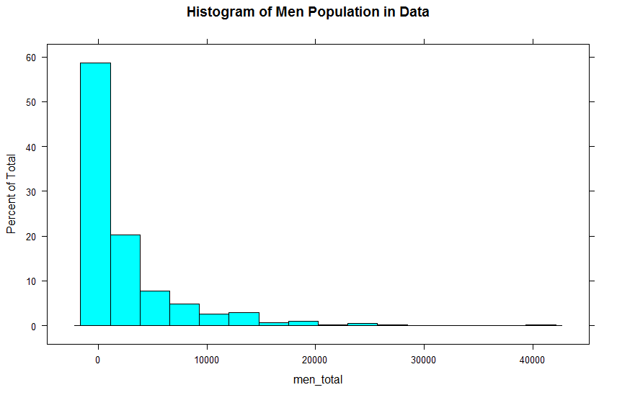
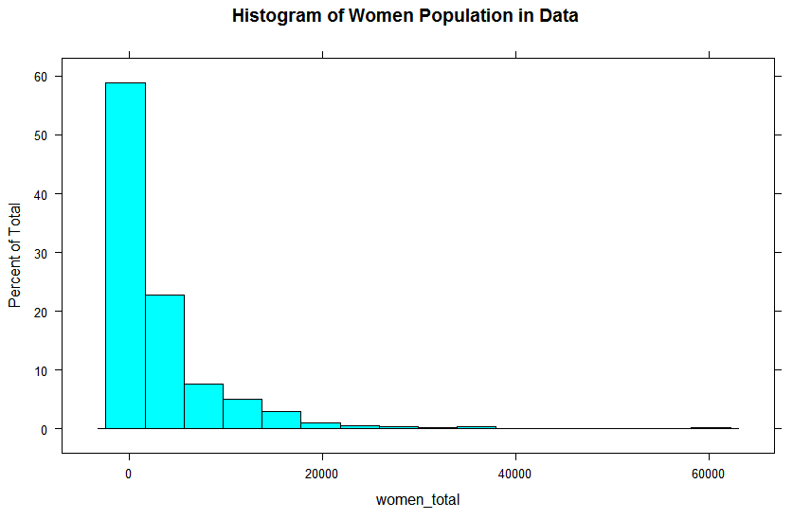
Output/Inferences
Histogram

Slide 7
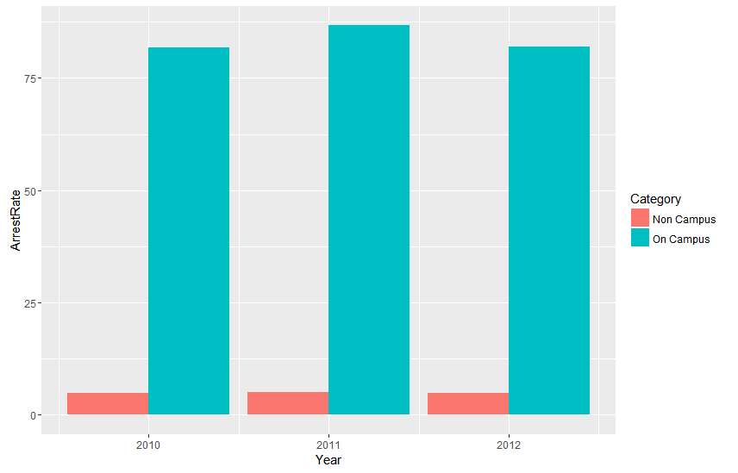
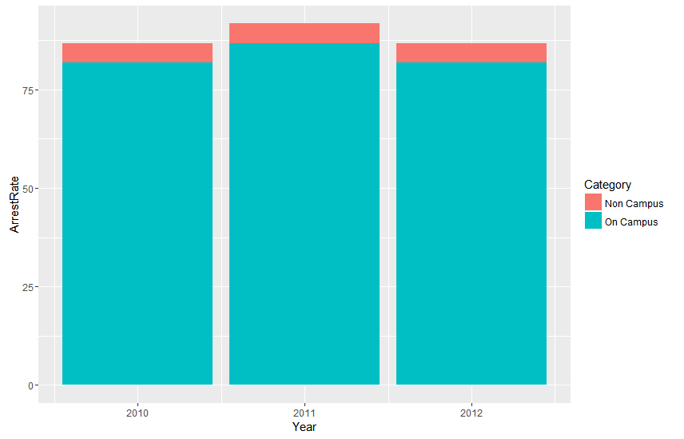
Output/Inferences
Bar Graph Stacked Bar Graph

Slide 8
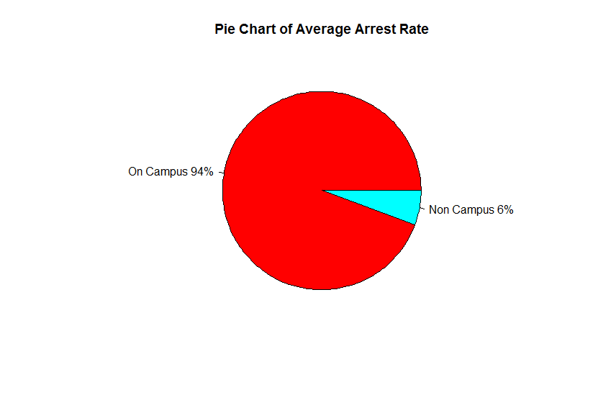
Output/Inferences
Pie Chart

Slide 9
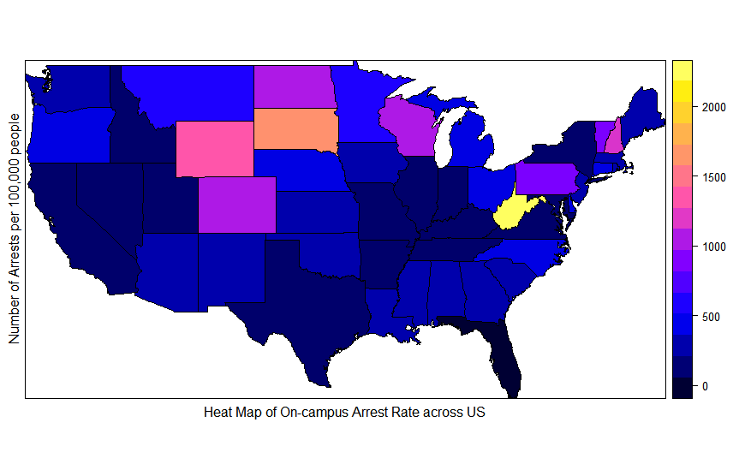
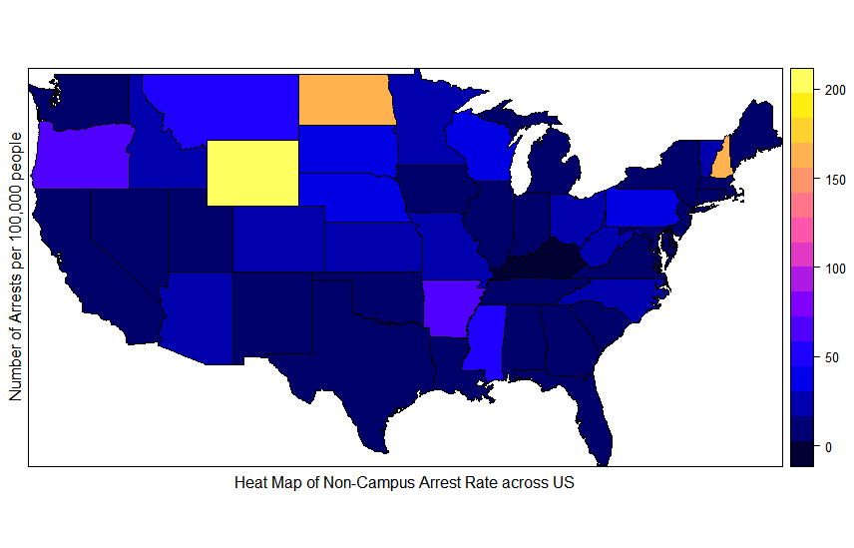
Output/Inferences
Heat Map

Slide 10
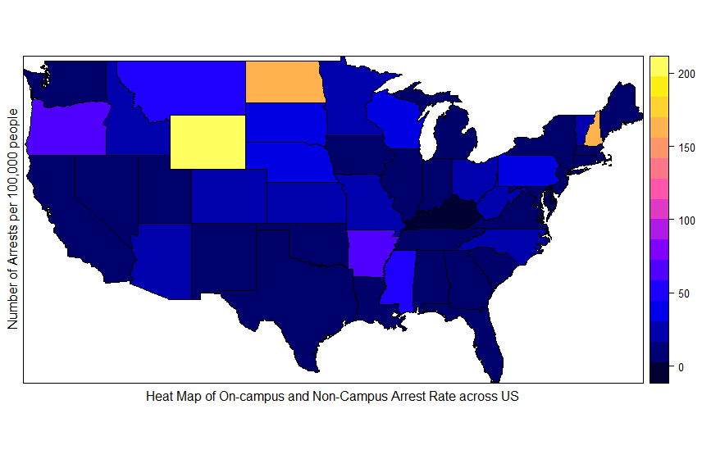
Output/Inferences
Heat Map

Slide 11
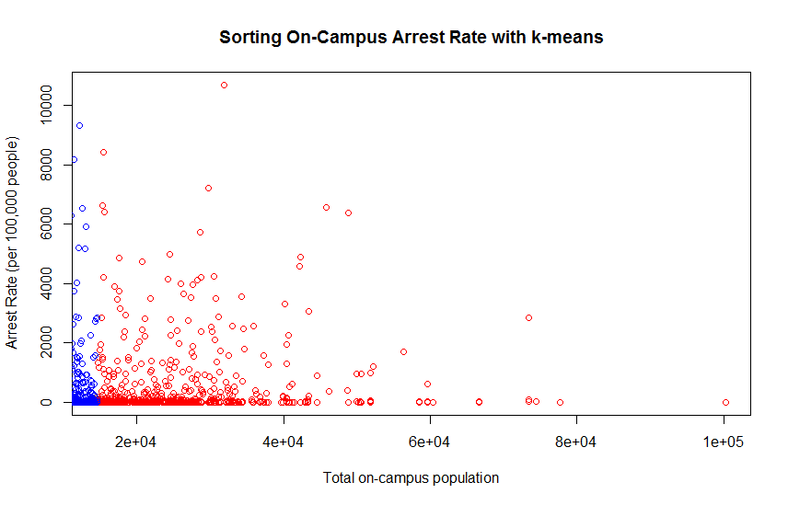
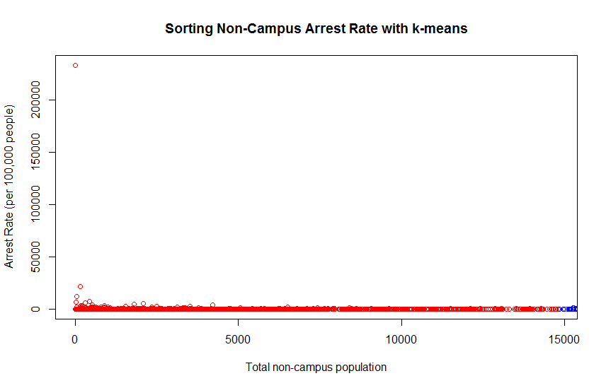
Output/Inferences
K-means Clustering

Slide 12
Conclusion
From above visualized data diagrams , we can safely conclude that on-campus arrest rate is higher compared to non-campus arrest rate.

Slide 13
References
http://catalog.data.gov/dataset/campus-safety-and-security-survey-2013
https://www.fbi.gov/about-us/cjis/ucr/crime-in-the-u.s/2012/crime-in-the-u.s.-2012/persons-arrested/persons-arrested
https://cran.r-project.org/web/packages/RMySQL/RMySQL.pdf
https://cran.r-project.org/web/packages/maptools/maptools.pdf
https://cran.r-project.org/web/packages/maps/maps.pdf

Slide 14
THANK YOU!

